Slide 1
Real World Edge Modules
Real World Edge
Market Therapy Landscape & Patient Count
Landing Page
Codeset
Cohort Builder
Patient Flow Analyzer
--- Reused from Evidence Fist Application

Slide 2







Technical Architecture for Codeset
Azure Ad & Microsoft Oauth
Front End
Vue Js
Python
API
App Service
Data Storage & Processing
My SQL Database
Elastic Search
Snowflake

Slide 3



Technical Architecture for Cohort Builder
Azure Ad & Microsoft Oauth
Front End
Vue Js
Python
API
App Service
Data Storage & Processing
My SQL Database
Snow Park

Slide 4

Technical Architecture for Patient Flow Analyzer
Azure Ad & Microsoft Oauth
Front End
API
App Service
Python
Data Storage & Processing
My SQL Database
Snow Park

Slide 5
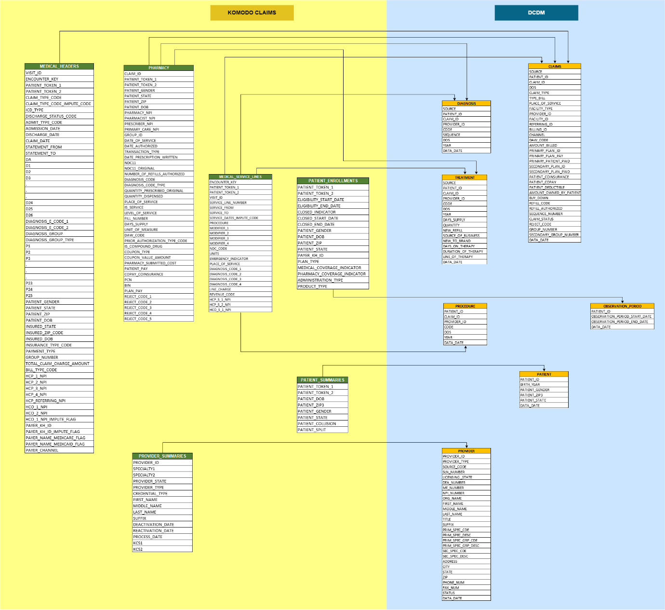
Trinity will define the destination data model and will build required data processing pipelines to integrate relevant datasets
Data Transformation and Preparation
Source Data Format
Common Data Model

